Slide 1
ARTIFICIAL INTELLIGENCE
UNIT-01
APPLIED COMPUTATIONAL SCIENCE & ENGINEERING

Slide 2
Artificial Intelligence
In today's world, technology is growing very fast, and we are getting in touch with different new technologies day by day.
Here, one of the booming technologies of computer science is Artificial Intelligence which is ready to create a new revolution in the world by making intelligent machines.
The Artificial Intelligence is now all around us. It is currently working with a variety of subfields, ranging from general to specific, such as self-driving cars, playing chess, proving theorems, playing music, Painting, etc.
AI is one of the fascinating and universal fields of Computer science which has a great scope in future. AI holds a tendency to cause a machine to work as a human.

Slide 3
Artificial Intelligence
Artificial Intelligence is composed of two words Artificial and Intelligence, where Artificial defines "man-made," and intelligence defines "thinking power", hence AI means "a man-made thinking power.“
So, we can define AI as:
"It is a branch of computer science by which we can create intelligent machines which can behave like a human, think like humans, and able to make decisions."
Artificial Intelligence exists when a machine can have human based skills such as learning, reasoning, and solving problems
With Artificial Intelligence you do not need to preprogram a machine to do some work, despite that you can create a machine with programmed algorithms which can work with own intelligence, and that is the awesomeness of AI.

Slide 4
Advantages of Artificial Intelligence
High Accuracy with less errors: AI machines or systems are prone to less errors and high accuracy as it takes decisions as per pre-experience or information.
High-Speed: AI systems can be of very high-speed and fast-decision making, because of that AI systems can beat a chess champion in the Chess game.
High reliability: AI machines are highly reliable and can perform the same action multiple times with high accuracy.

Slide 5
Advantages of Artificial Intelligence
Useful for risky areas: AI machines can be helpful in situations such as defusing a bomb, exploring the ocean floor, where to employ a human can be risky.
Digital Assistant: AI can be very useful to provide digital assistant to the users such as AI technology is currently used by various E-commerce websites to show the products as per customer requirement.
Useful as a public utility: AI can be very useful for public utilities such as a self-driving car which can make our journey safer and hassle-free, facial recognition for security purpose, Natural language processing to communicate with the human in human-language, etc.

Slide 6
Disadvantages of Artificial Intelligence
High Cost: The hardware and software requirement of AI is very costly as it requires lots of maintenance to meet current world requirements.
Can't think out of the box: Even we are making smarter machines with AI, but still they cannot work out of the box, as the robot will only do that work for which they are trained, or programmed.
No feelings and emotions: AI machines can be an outstanding performer, but still it does not have the feeling so it cannot make any kind of emotional attachment with human, and may sometime be harmful for users if the proper care is not taken.

Slide 7
Disadvantages of Artificial Intelligence
Increase dependency on machines: With the increment of technology, people are getting more dependent on devices and hence they are losing their mental capabilities.
No Original Creativity: As humans are so creative and can imagine some new ideas but still AI machines cannot beat this power of human intelligence and cannot be creative and imaginative.

Slide 8
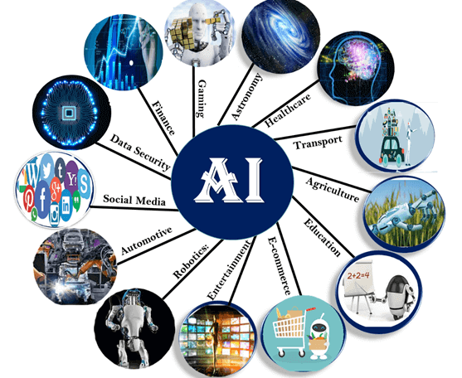
Application of AI

Slide 9
Application of AI
AI in Astronomy Artificial Intelligence can be very useful to solve complex universe problems. AI technology can be helpful for understanding the universe such as how it works, origin, etc.
AI in Healthcare In the last, five to ten years, AI becoming more advantageous for the healthcare industry and going to have a significant impact on this industry.
Healthcare Industries are applying AI to make a better and faster diagnosis than humans. AI can help doctors with diagnoses and can inform when patients are worsening so that medical help can reach to the patient before hospitalization.
AI in Gaming AI can be used for gaming purpose. The AI machines can play strategic games like chess, where the machine needs to think of a large number of possible places.
AI in Finance AI and finance industries are the best matches for each other. The finance industry is implementing automation, Chabot, adaptive intelligence, algorithm trading, and machine learning into financial processes.

Slide 10
Application of AI
AI in Data Security The security of data is crucial for every company and cyber-attacks are growing very rapidly in the digital world. AI can be used to make your data more safe and secure. Some examples such as AEG bot, AI2 Platform, are used to determine software bug and cyber-attacks in a better way.
AI in Social Media Social Media sites such as Facebook, Twitter, and Snapchat contain billions of user profiles, which need to be stored and managed in a very efficient way. AI can organize and manage massive amounts of data. AI can analyze lots of data to identify the latest trends, hashtag, and requirement of different users.
AI in Travel & Transport AI is becoming highly demanding for travel industries. AI is capable of doing various travel related works such as from making travel arrangement to suggesting the hotels, flights, and best routes to the customers. Travel industries are using AI-powered chat bots which can make human-like interaction with customers for better and fast response.

Slide 11
Application of AI
AI in Automotive Industry Some Automotive industries are using AI to provide virtual assistant to their user for better performance. Such as Tesla has introduced TeslaBot, an intelligent virtual assistant. Various Industries are currently working for developing self-driven cars which can make your journey more safe and secure.
AI in Robotics Artificial Intelligence has a remarkable role in Robotics. Usually, general robots are programmed such that they can perform some repetitive task, but with the help of AI, we can create intelligent robots which can perform tasks with their own experiences without pre-programmed. Humanoid Robots are best examples for AI in robotics, recently the intelligent Humanoid robot named as Erica and Sophia has been developed which can talk and behave like humans.

Slide 12
Application of AI
AI in Entertainment We are currently using some AI based applications in our daily life with some entertainment services such as Netflix or Amazon. With the help of ML/AI algorithms, these services show the recommendations for programs or shows.
AI in Agriculture Agriculture is an area which requires various resources, labor, money, and time for best result. Now a day's agriculture is becoming digital, and AI is emerging in this field. Agriculture is applying AI as agriculture robotics, solid and crop monitoring, predictive analysis. AI in agriculture can be very helpful for farmers.
AI in E-commerce AI is providing a competitive edge to the e-commerce industry, and it is becoming more demanding in the e-commerce business. AI is helping shoppers to discover associated products with recommended size, color, or even brand.
AI in education: AI can automate grading so that the tutor can have more time to teach. AI chatbot can communicate with students as a teaching assistant. AI in the future can be work as a personal virtual tutor for students, which will be accessible easily at any time and any place.

Slide 13
AGENT
An agent can be anything that perceive its environment through sensors and act upon that environment through actuators. An Agent runs in the cycle of perceiving, thinking, and acting. An agent can be:
Human-Agent: A human agent has eyes, ears, and other organs which work for sensors and hand, legs, vocal tract work for actuators.
Robotic Agent: A robotic agent can have cameras, infrared range finder, NLP for sensors and various motors for actuators.
Software Agent: Software agent can have keystrokes, file contents as sensory input and act on those inputs and display output on the screen.
Hence the world around us is full of agents such as thermostat, cellphone, camera, and even we are also agents.

Slide 14
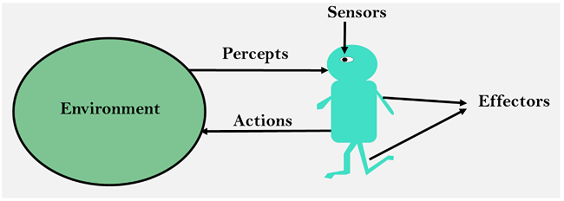
AGENT
Sensor: Sensor is a device which detects the change in the environment and sends the information to other electronic devices. An agent observes its environment through sensors.
Actuators: Actuators are the component of machines that converts energy into motion. The actuators are only responsible for moving and controlling a system. An actuator can be an electric motor, gears, rails, etc.
Effectors: Effectors are the devices which affect the environment. Effectors can be legs, wheels, arms, fingers, wings, fins, and display screen.

Slide 15
Intelligent Agent
An intelligent agent is an autonomous entity which act upon an environment using sensors and actuators for achieving goals. An intelligent agent may learn from the environment to achieve their goals. A thermostat is an example of an intelligent agent.
Following are the main four rules for an AI agent:
Rule 1: An AI agent must have the ability to perceive the environment.
Rule 2: The observation must be used to make decisions.
Rule 3: Decision should result in an action.
Rule 4: The action taken by an AI agent must be a rational action.

Slide 16
Rational Agent
A rational agent is an agent which has clear preference, models uncertainty, and acts in a way to maximize its performance measure with all possible actions.
A rational agent is said to perform the right things. AI is about creating rational agents to use for game theory and decision theory for various real-world scenarios.
For an AI agent, the rational action is most important because in AI reinforcement learning algorithm, for each best possible action, agent gets the positive reward and for each wrong action, an agent gets a negative reward.

Slide 17
Structure of an AI Agent
The task of AI is to design an agent program that implements the agent function. The structure of an intelligent agent is a combination of architecture and agent program. It can be viewed as:
Agent = Architecture + Agent program
Following are the main three terms involved in the structure of an
AI agent:
Architecture: Architecture is machinery that an AI agent executes on.
Agent Function: Agent function is used to map a percept to an action.
Agent program: Agent program is an implementation of agent function. An agent program executes on the physical architecture to produce function .

Slide 18
Types of Agents
In artificial intelligence, an agent is a computer program or system that is designed to perceive its environment, make decisions and take actions to achieve a specific goal or set of goals.
Agents can be grouped into five classes based on their degree of perceived intelligence and capability :
Simple Reflex Agents
Model-Based Reflex Agents
Goal-Based Agents
Utility-Based Agents
Learning Agent
Multi-agent systems
Hierarchical agents

Slide 19
Simple Reflex Agents
Simple reflex agents ignore the rest of the percept history and act only on the basis of the current percept.
Percept history is the history of all that an agent has perceived to date.
Problems with Simple reflex agents are :
Very limited intelligence.
No knowledge of non-perceptual parts of the state.
Usually too big to generate and store.
If there occurs any change in the environment, then the collection of rules needs to be updated.

Slide 20
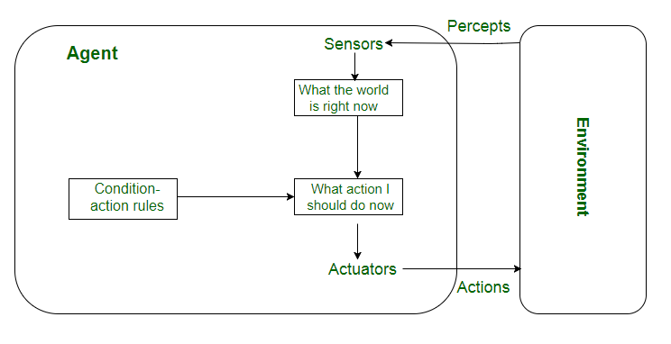

Slide 21
Model-Based Reflex Agents
It works by finding a rule whose condition matches the current situation.
They use a model of the world to choose their actions. They maintain an internal state.
Model − knowledge about “how the things happen in the world”.
Internal State − It is a representation of unobserved aspects of current state depending on percept history.
Updating the state requires the information about −
How the world evolves.
How the agent’s actions affect the world.
.

Slide 22
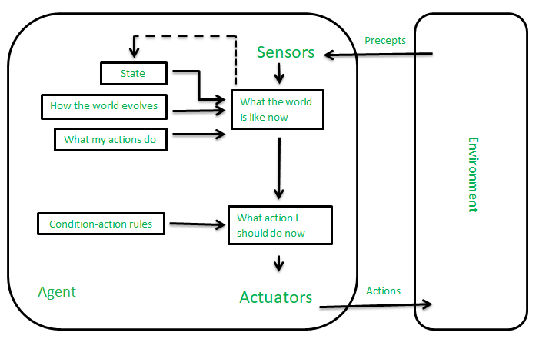

Slide 23
Goal-Based Agents
These kinds of agents take decisions based on how far they are currently from their goal(description of desirable situations).
Their every action is intended to reduce their distance from the goal. This allows the agent a way to choose among multiple possibilities, selecting the one which reaches a goal state.
They usually require search and planning. The goal-based agent’s behavior can easily be changed.

Slide 24
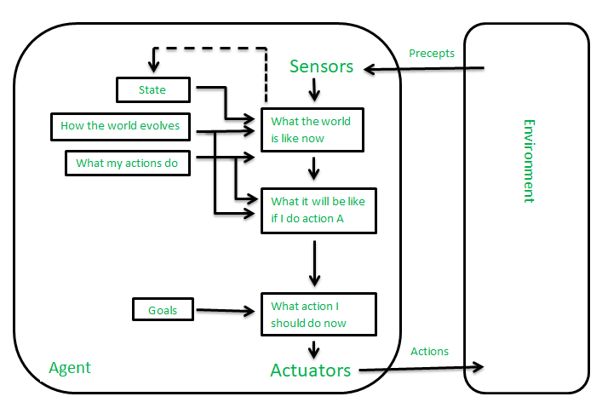

Slide 25
Utility-Based Agents
The agents which are developed having their end uses as building blocks are called utility-based agents.
When there are multiple possible alternatives, then to decide which one is best, utility-based agents are used. They choose actions based on a preference (utility) for each state. Sometimes achieving the desired goal is not enough.
They choose actions based on a preference (utility) for each state.
Goals are inadequate when −
There are conflicting goals, out of which only few can be achieved.
Goals have some uncertainty of being achieved and you need to weigh likelihood of success against the importance of a goal.

Slide 26
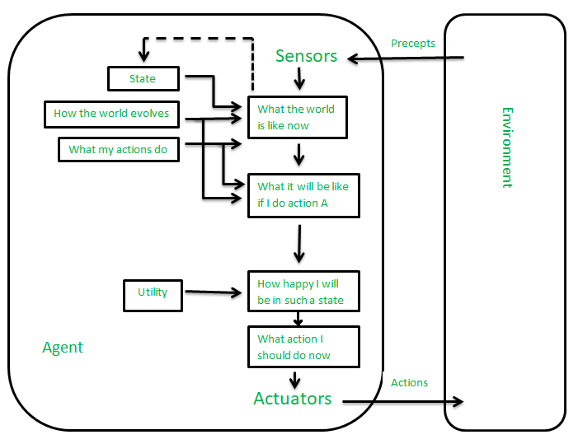

Slide 27
Learning Agent
A learning agent in AI is the type of agent that can learn from its past experiences or it has learning capabilities. It starts to act with basic knowledge and then is able to act and adapt automatically through learning.
A learning agent has mainly four conceptual components, which are:
Learning element: It is responsible for making improvements by learning from the environment.
Critic: The learning element takes feedback from critics which describes how well the agent is doing with respect to a fixed performance standard.
Performance element: It is responsible for selecting external action.
Problem Generator: This component is responsible for suggesting actions that will lead to new and informative experiences.

Slide 28
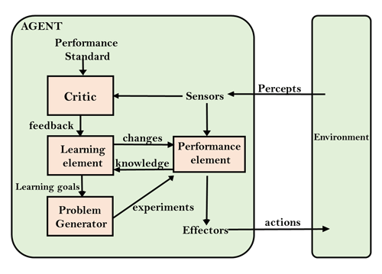

Slide 29
Multi-Agent Systems
These agents interact with other agents to achieve a common goal. They may have to coordinate their actions and communicate with each other to achieve their objective.
A multi-agent system (MAS) is a system composed of multiple interacting agents that are designed to work together to achieve a common goal.

Slide 30
Hierarchical Agents
These agents are organized into a hierarchy, with high-level agents overseeing the behavior of lower-level agents.
The high-level agents provide goals and constraints, while the low-level agents carry out specific tasks.
Hierarchical agents are useful in complex environments with many tasks and sub-tasks.
In a simple system, there may be only two levels: high-level agents and low-level agents.
In a more complex system, there may be multiple levels, with intermediate-level agents responsible for coordinating the activities of lower-level agents.
One advantage of hierarchical agents is that they allow for more efficient use of resources.
By organizing agents into a hierarchy, it is possible to allocate tasks to the agents that are best suited to carry them out, while avoiding duplication of effort. This can lead to faster, more efficient decision-making and better overall performance of the system.

Slide 31
The Functions of an Artificial Intelligence Agent
The functions of an agent in artificial intelligence are as follows:
To resolve complex issues using intelligent machines.
To decide what to do in a specific situation.
To make conclusions and take decisions.
The perception of dynamic environmental circumstances.
Using logic to interpret perceptions.
To make an effort to change environmental conditions.

Slide 32
Use-cases of Agents
Robotics Autonomous systems Smart homes and buildings Transportation systems Traffic management Intelligent personal assistants Healthcare Finance Games Natural language processing Cybersecurity Environmental monitoring Social media

Slide 33
PEAS Representation
PEAS is a type of model on which an AI agent works upon. When we define an AI agent or rational agent, then we can group its properties under PEAS representation model. It is made up of four words:
P: Performance measure
E: Environment
A: Actuators
S: Sensors

Slide 34
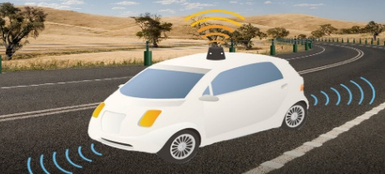
PEAS for self-driving cars

Slide 35
Self-driving cars
Let's suppose a self-driving car then PEAS representation will be:
Performance: Safety, time, legal drive, comfort
Environment: Roads, other vehicles, road signs
Actuators: Steering, accelerator, brake, signal, horn
Sensors: Camera, GPS, speedometer, odometer, accelerometer, sonar.

Slide 36
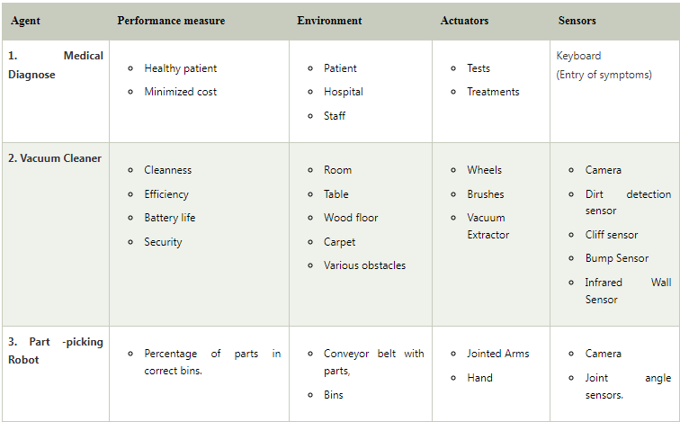
Example of Agents with their PEAS representation

Slide 37
Problem Solving Techniques in AI
Problem-solving is a process that is used to achieve goals or solve specific situations.
In computer science, problem-solving refers to the use of artificial intelligence methods such as algorithms and root-cause analyses.
AI problem-solving involves investigating potential solutions through reasoning techniques and using modelling frameworks.
Each problem may have multiple solutions, each achieved with a unique algorithm.
Some problems may have original remedies, meaning that new and innovative solutions may be required.
The approach to problem-solving depends on how the situation is framed. Different perspectives or viewpoints may lead to different approaches in finding solutions.

Slide 38
Cases involving Artificial Intelligence Issues
Artificial intelligence is being utilized by programmers globally for automating systems and improving resource and time management.
AI algorithms are highly effective in solving various games and puzzles, including mathematics challenges, logical puzzles, Sudoku, and Chess.
AI has successfully resolved common issues in these areas through its applications and advancements.

Slide 39
Cases involving Artificial Intelligence Issues
Chess
N-Queen problem: The N Queen is the problem of placing N chess queens on an N×N chessboard so that no two queens attack each other.
Tower of Hanoi Problem
Travelling Salesman Problem
Water-Jug Problem

Slide 40
Approaches for Resolving Problems
Problem Solving Agent: When the correct action to take is not immediately obvious, an agent may need to plan ahead, to consider a sequence of actions that form a path to a goal state. Such an agent is problem problem-solving agent.
And the computational process it undertakes is called search.
The effective approaches of artificial intelligence make it useful for resolving complicated issues.
All fundamental problem-solving methods used throughout AI were listed below.

Slide 41
Problem Solving Process
When the agent knows the environment then it follows the below process. And if the agent doesn’t know the environment then the agent performs actions at random.
Goal Formation: Goals organize behaviour by limiting the objectives.
Problem Formulation: the agent devises a description of the states and actions necessary to reach the goal.
Search: Searching until it finds a sequence of actions that reaches the Goal.
Execution: Agent Executes the actions in the solution one at a time.

Slide 42
Heuristics
The heuristic approach relies on experimentation and testing to understand and solve problems.
Heuristics may not always provide the best solution to a specific problem, but they can be effective for achieving short-term objectives.
Developers often resort to heuristics when traditional techniques fail to solve a problem effectively.
Heuristics are used together with optimization algorithms to increase efficiency, as they offer quick alternatives but may sacrifice accuracy.

Slide 43
Searching Algorithms
AI solves challenges through searching algorithms, using molecular representations.
These algorithms have attributes like completeness, optimality, time complexity, and high computational efficiency, making them crucial for problem-solving.

Slide 44
Computing Evolutionary
The evolutionary theory of "survival of the fittest" suggests that when a species successfully reproduces in a changing environment, its coping mechanisms are passed down to future generations, creating new species.
Mutated animals combine traits that fit the harsh environment, making them not clones of the old ones. Humanity, as an example, has evolved and expanded due to the accumulation of advantageous mutations over numerous generations, demonstrating the impact of evolution on development.

Slide 45
Genetic Algorithms
Genetic algorithms, based on evolutionary theory, use direct random search to combine the healthiest options for a desirable offspring.
The fit factor is calculated by gathering demographic information and assessing each individual's overall health.
The creators then employ various methodologies to retain the best participants, ensuring the best outcomes for the offspring.

Slide 46
Thank you

